Slide 1
Contoso Bank Limited
Serena Toon
serenatoon@outlook.com
Notes:
Please enter project details and your details here.

Slide 2
A bit about myself ☺
Heavily interested in tech (computers, mobile, electronics)
3rd year Computer Systems Engineering student
Best part of MSA was exposure to different toolkits
Could improve on making sure code is working before presenting
Future goals:
secure a grad role in the computer systems engineering industry
i.e. not pure software dev
Notes:
This section is NOT assessed. We just want to get to know you ☺.

Slide 3
UI/UX
Custom branding, logos
Bouncing button to talk to the bot
What you can do with the bot is displayed on webpage
Confirmation of actions from bot
Information from bot is presented in a friendly manner
Notes:
User Experience

Slide 4
Databases
2 tables:
Balances
Transactions
Balances
Username, account name, balance, account number
Transactions
Username, transaction amount, transaction type, timestamp, to_account, from_account
Notes:
Talk about your database, what schema you used and what data you used

Slide 5
API
Alpha Vantage for stock market data
Gets yesterday’s closing price of an input stock symbol
Ask the bot “MSFT share price”
Output in card showing yesterday’s closing price
Plus other data (opening, high, low, etc)
Notes:
Advanced features…

Slide 6
Azure Setup
Bot is hosted on Azure, registered on Bot Framework
Notes:
Explain your Azure features here

Slide 7
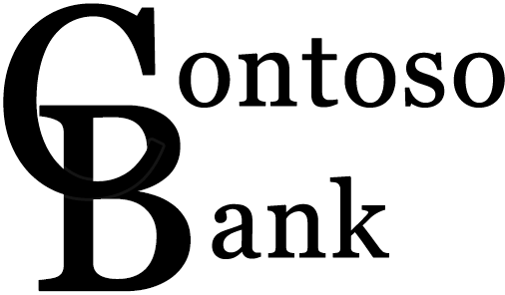
Advanced Features
Custom branding
Responsive website
Notes:
Advanced features…

Slide 8
Final Comments
Future improvements:
More functionality to bot
e.g. userdata
Fail gracefully to user
Better webpage
Notes:
Any final things you want to tell us

